Slide 1
Interpretability of transformer models and Comparison of Interpretability Tools
By Fahim Ishrak
Dats 6501- Data Science Capstone
Date - 12/07/2020

Slide 2
Why interpretability?
Black box notion of models
Help builds transparency and trust of the model’s prediction

Slide 3
Why NLP/transformer models?
Less interpretability tools for NLP compared to Images
Transformer models are fairly recent (BERT released on May 2019)

Slide 4
Comparison of the tools of interpretability
In addition to looking at interpretability, a look at how the different tools interpret their results
Work with LIME (Local Interpretable Model-Agnostic Explanations) and Integrated Gradients

Slide 5
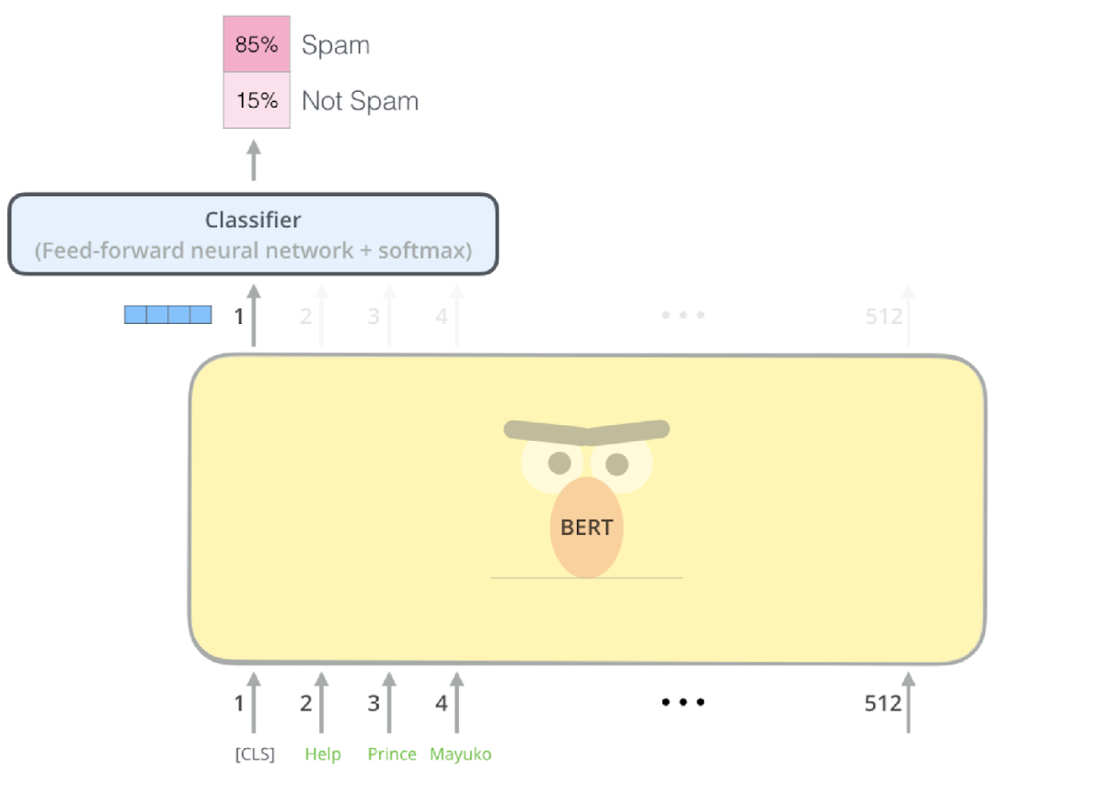
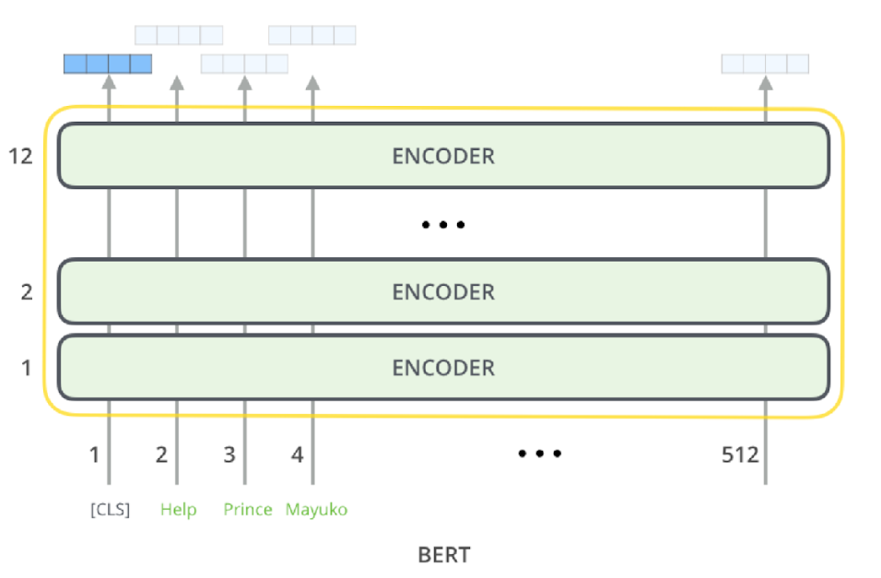
What is a transformer model?
Series of encoders stacked on top of each other
With the output layer modified according to our task
illustrations taken from https://jalammar.github.io/illustrated-transformer/

Slide 6
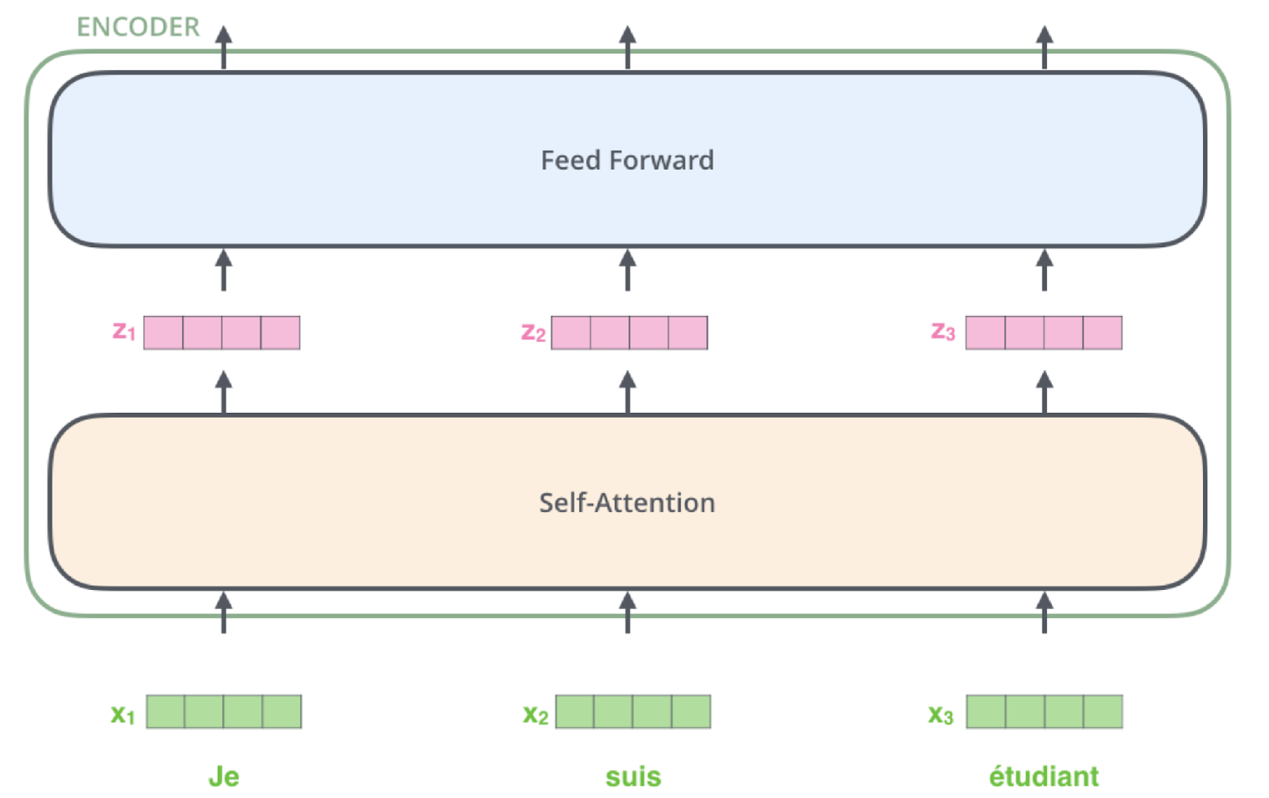
What is an Encoder?
Comprised of an Attention Layer and a Feed Forward Layer
Attention Layer - As the model processes each word (each position in the input sequence), self attention allows it to look at other positions in the input sequence for clues that can help lead to a better encoding for the word
Feed Forward Layer - Stacks of Encoding RNNs
illustrations taken from https://jalammar.github.io/illustrated-transformer/

Slide 7
Tools of interpretability - LIME (Local Interpretable Model-Agnostic Explanations)
LIME is a local surrogate model, which means that it is a trained model used to approximate the predictions of the underlying black-box model.
The idea is to generate variations of the data into the machine learning model and tests what happens to the predictions, using this changed data as a training set instead of using the original training data.
On this new dataset, LIME then trains an interpretable model (e.g., Lasso, decision tree), which is weighted by the proximity of the sampled instances to the instance of interest.

Slide 8
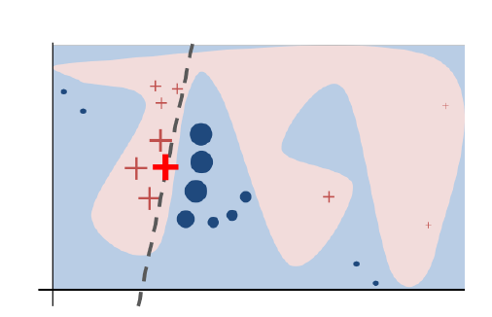
Tools of interpretability - LIME (Local Interpretable Model-Agnostic Explanations) (Continued)
Image taken from
Marco T, R, Sameer S, and Carlos G. ” why should i trust you?”explaining the predictions of any classifier.
The bold red cross is the instance being explained. LIME samples instances, gets predictions using the black-box model (represented by the blue/pink background), and weighs them by the proximity to the instance being explained (represented here by size). The dashed line is the learned local explanation.

Slide 9
Tools of interpretability - Integrated Gradients
Early interpretability methods for neural networks assigned feature importance scores using gradients, which tell you which pixels or texts have the steepest local relative to your model's prediction at a given point along your model's prediction function.
A baseline is needed so that the gradient doesn’t saturate and go to zero
A baseline is a white input image or a zero embedding vector used as a starting point for calculating feature importance.
Intuitively, the baseline's explanatory role is representing the impact of the absence of each pixel or text prediction and it contrast with the impact of the presence of each pixel or text prediction.

Slide 10
Tools of interpretability - Integrated Gradients
The approach taken by integrated gradients is to ask the following question: what is something that can be calculated which is an analogy to the gradient and also acknowledges the presence of a baseline.
What Integrated Gradients does is calculate the integral of the gradients between the baseline and the point of interest. This integral is what gives the feature importance of a pixel or a text

Slide 11
Methodology
The dataset picked for this task is the restaurant reviews dataset and the Stanford Treebank dataset. Both of them are binary classification datasets.
The dataset structure is simple, containing only the texts and corresponding sentiment.
For preprocessing, it is made sure that the classes are not imbalanced and this is resolved by under-sampling the majority class.

Slide 12
Methodology
Afterward, the dataset is trained on a pre-trained BERT model and a CNN model. The CNN model is a baseline against which the BERT model will be compared.
The models are then ready to be shipped to LIME and captum to see how it predicts on specific sentences from the dataset.

Slide 13
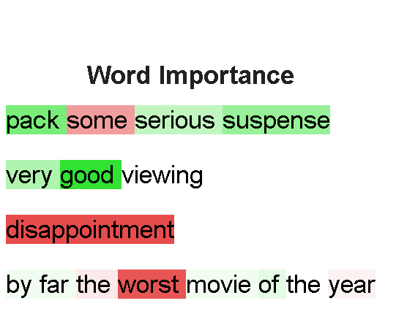
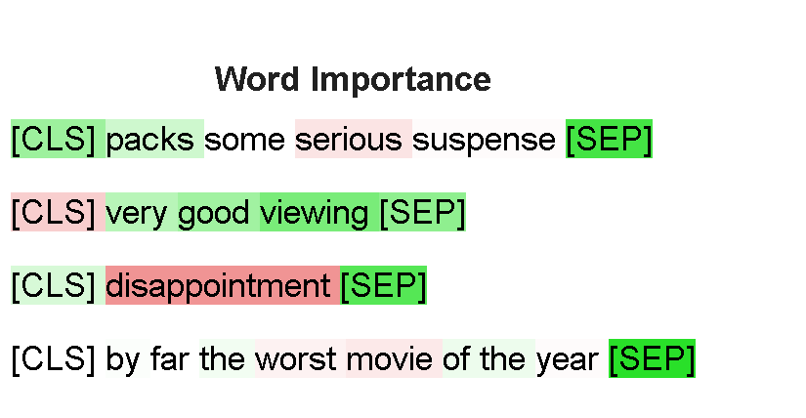
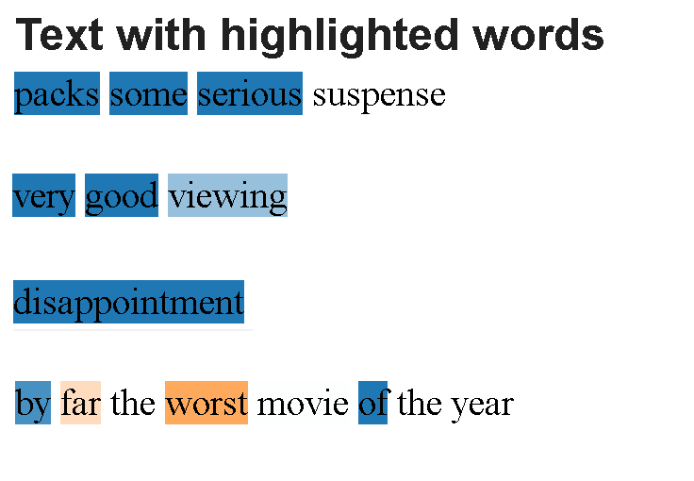
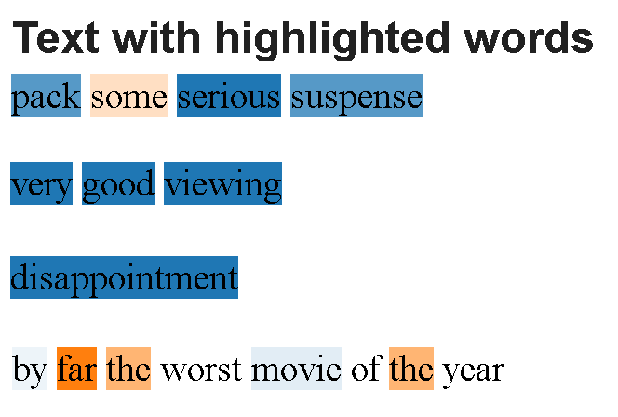
Results for SST dataset
BERT
CNN
INTEGRATED GRADIENTS
LIME

Slide 14
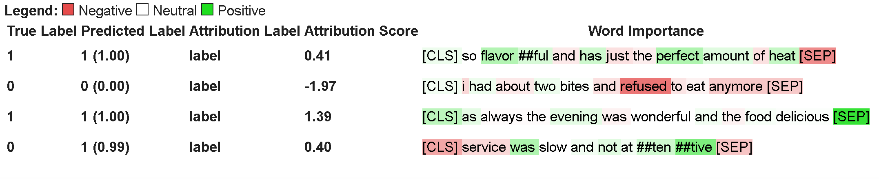
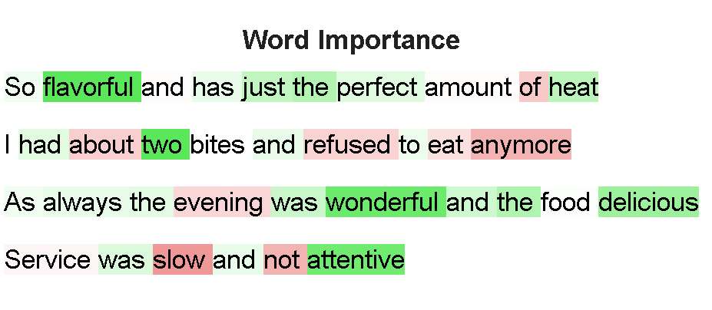
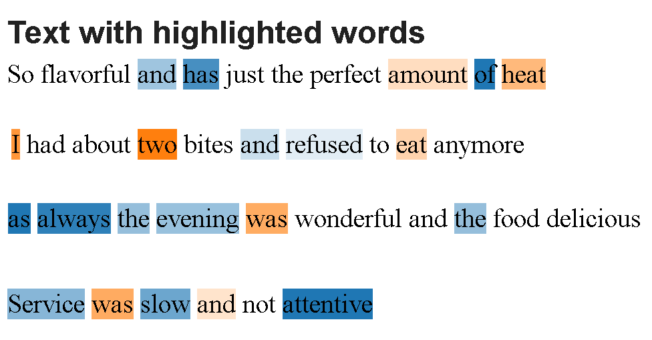
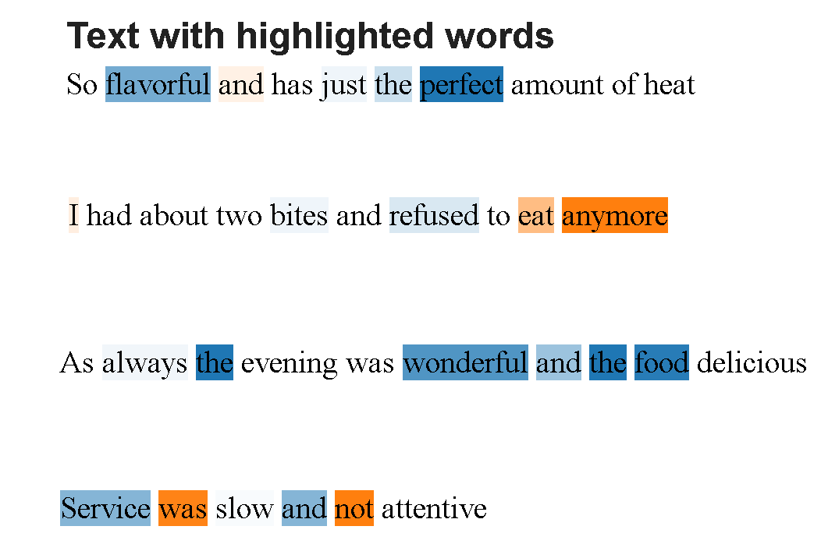
Results for Restaurant Reviews dataset
BERT
CNN
INTEGRATED GRADIENTS
LIME

Slide 15
Conclusion
From the results, it can be seen that integrated gradients give more reliable and consistent interpretations when compared to LIME.
When comparing the transformer model, BERT, to the baseline CNN model, BERT gives similar results but it is less 'condent' and a bit inconsistent when interpreting a sentence.

Slide 16
Future Work
More conclusive results can be provided if the models are trained on more datasets and larger datasets.
At the moment, integrated gradients doesn't handle multiclass sentiments but it would be interesting to look at how the models would interpret more than two sentiments.
More transformer model can be added to the comparison
Use more tools for comparison like SHAP and see how they are interpreting the results.

Slide 17
References
1.Jacob Devlin, Ming-Wei Chang, Kenton Lee, and Kristina Toutanova. Bert: Pre-training of deep bidirectional transformers for language understanding. arXiv preprint arXiv:1810.04805, 2018.
2. Sosuke Kobayashi. Homemade bookcorpus. https://github.com/BIGBALLON/cifar-10-cnn, 2018.
3. Narine Kokhlikyan, Vivek Miglani, Miguel Martin, Edward Wang, Bilal Alsallakh, Jonathan Reynolds, Alexander Melnikov, Natalia Kliushkina, Carlos Araya, Siqi Yan,et al. Captum: A unied and generic model interpretability library for pytorch. arXiv preprint arXiv:2009.07896, 2020.
4. Hui Liu, Qingyu Yin, and William Yang Wang. Towards explainable nlp: A generative explanation framework for text classication. arXiv preprint arXiv:1811.00196, 2018.
5. Jianmo Ni, Jiacheng Li, and Julian McAuley. Justifying recommendations using distantly-labeled reviews and ne-grained aspects. In Proceedings of the 2019 Conference on Empirical Methods in Natural Language Processing and the 9th International Joint Conference on
Natural Language Processing (EMNLP-IJCNLP), pages 188{197,2019.
6. Marco Tulio Ribeiro, Sameer Singh, and Carlos Guestrin. " why should i trust you?" explaining the predictions of any classier. In Proceedings of the 22nd ACM SIGKDD international conference on knowledge discovery and data mining, pages 1135{1144, 2016.
7. Alexander M Rush. The annotated transformer. In Proceedings of workshop for NLP open source software (NLP-OSS), pages 52{60, 2018.
8. Mukund Sundararajan, Ankur Taly, and Qiqi Yan. Axiomatic attribution for deep networks. arXiv preprint arXiv:1703.01365, 2017.

Slide 18


